Slide 1


Slide 2
Module-2(9 Hours) Demand Analysis
Law of Demand
Exceptions to the Law of Demand
Elasticity of Demand
Classification of Price
Income &Cross elasticity
Promotional elasticity of demand
Uses of elasticity of demand for
Managerial decision making
Measurement of elasticity of demand
Law of supply
Elasticity of supply.
Demand forecasting
Meaning
Significance
Methods of demand forecasting.
(Problems on Price elasticity of demand, and demand forecasting using Time-series method).

Slide 3

Demand
Demand refers to the quantity of goods and services that consumers are willing and able to buy at a given prices during a specific period of time. Demand requires willingness to buy, purchasing power, and a specific timeframe. For example, if consumers buy 1,000 units of a product at ₹20, it represents the demand at that price.

Slide 4
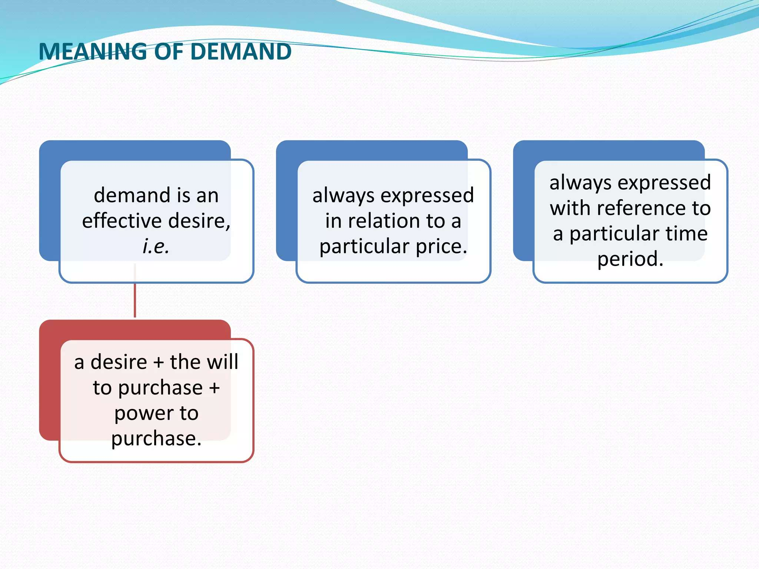

Slide 5
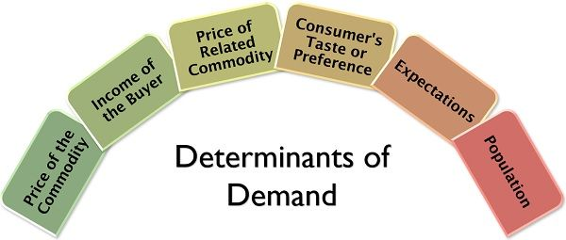

Slide 6
Demand= Desire + Able to pay + Willingness to spend
It is a relative concept (price, time, place)
Types of Demand:
Individual demand & Market demand
Demand for capital goods & consumer goods
Autonomous demand & Derived demand OR Direct & Indirect demand
Demand for durable goods & non durable goods
Short term & long term demand
Ex-ante and ex-post demand
Others

Slide 7
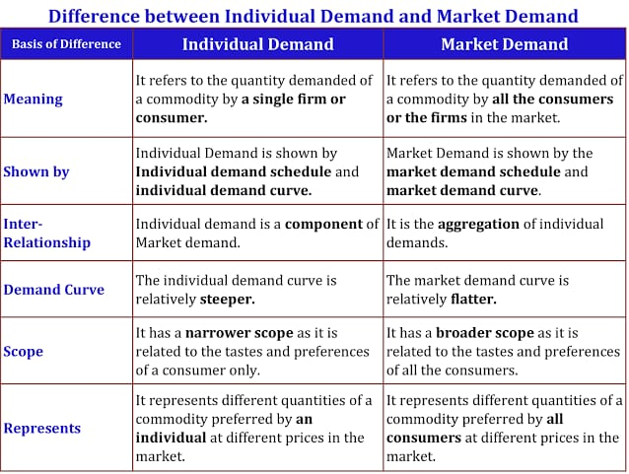

Slide 8
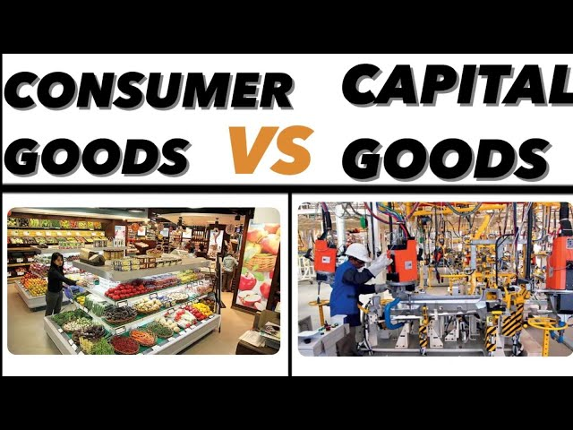

Slide 9
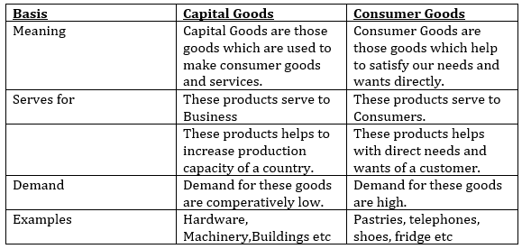

Slide 10
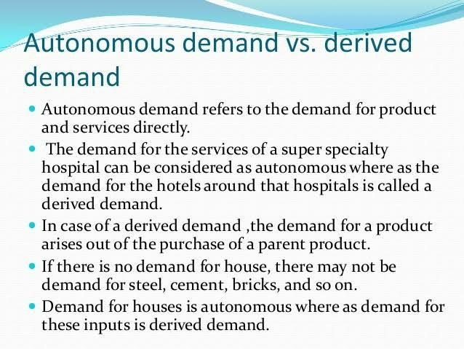

Slide 11
Ex-ante(Expected/Planned Demand)and ex-post demand(Actual Demand/Realized Demand)
Ex-ante demand refers to the amount of a product consumers plan or intend to buy during a future period. It is based on expectations, forecasting, and intentions before actual purchase happens. Ex-post demand refers to the actual quantity purchased or consumed during a time period. It is the realized demand, measured after the purchase takes place.

Slide 12
Demand Analysis
A comprehensive process used by businesses and economists to understand and predict the demand for a product or service
Why it is needed….?????
To provide the basis for analyzing market influences on the demand.
To provide the guidance for manipulating the demand.
To guide in production planning through forecasting the demand.

Slide 13
Demand Function
A demand function is a mathematical terms expresses the functional relationship between the demand for the product and its various determining variables. In simple words it describes the relationship between a variable (dependent variable) and its determinants (independent variables)
Dx=f(Px, Ps, Pc, Yd, T, A, N, u)
Dx - Demand of goods x
Px – Price of goods x
Ps – Price of substitutes of x
Pc – Price of complements of x
Yd – Income level
T – Taste of consumers
A – Advertisement expenditure
N – Number of consumers
u – Others

Slide 15
Law of Demand
The law of demand states that other factors being constant the quantity demanded of a good varies inversely with its price. It shows an inverse relationship between the price of a commodity and quantity demanded for good or service assuming all other factors affecting demand remain constant.
This means, when price increases demand decreases, and when price decreases demand increases.
The Law of Demand states that amount demanded increases with a fall in price and diminishes when price increases." - Prof. Marshall

Slide 16
Characteristics of law of demand
There is inverse relationship between price of commodity and its demand.
Price an Independent Variable and Demand is Dependent Variable on price of goods.
It is a Qualitative Statement.
Other thing remains the same.

Slide 17
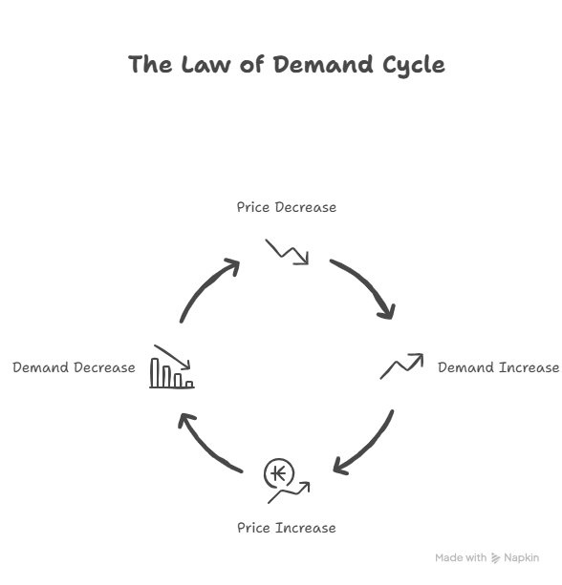

Slide 18
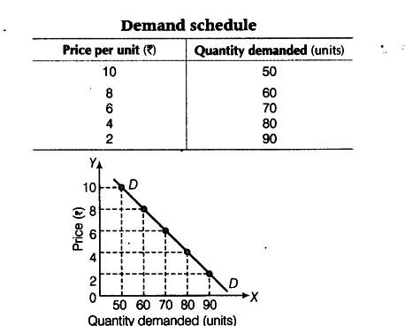

Slide 19
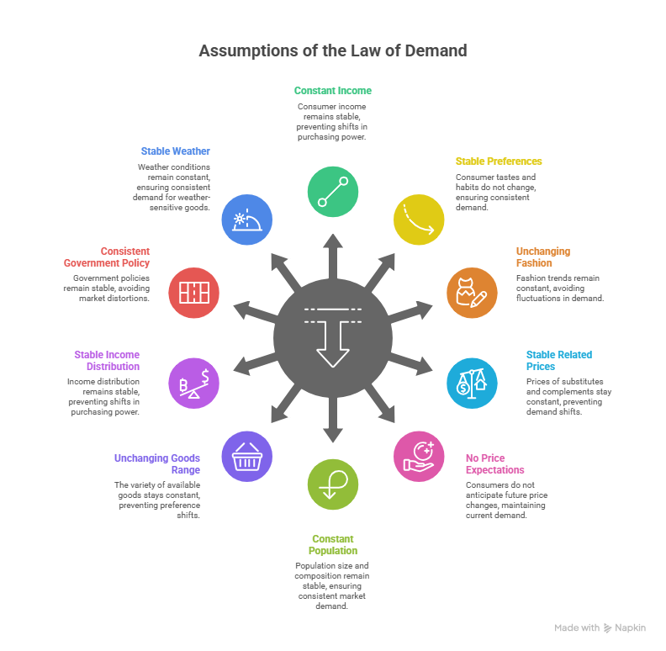

Slide 20
Assumptions
No Change in Consumer’s Income: Throughout the law, the consumer’s income should remain the same. If the level of buyer’s income changes, he may buy more even at a higher price, invalidating the law of demand.
No Change in Tastes, Habits, or Preferences: The consumer’s taste, habits and preferences should remain constant. If suddenly there is a trend toward healthy eating, demand for apples may rise even if price increases.
No change in the Fashion: if the commodity concerned go out of the fashion, a buyer may not buy more of it even at a substantial price of reduction.
No change in the Prices of Related Goods: Prices of other goods like substitutes and supportive i.e., complementary or jointly demanded products remain unchanged. If the prices of other related goods change, the consumer’s preferences would change which may invalidate the law of demand.

Slide 21
No Expectation of Future Price Changes or Shortages: The law requires that the given price change for the commodity is a normal one and has no speculative consideration. That is to say, the buyers do not expect any shortages in the supply of the commodity in the market and consequent future changes in the prices. The given price change is assumed to be final at a time.
No Change in Population Size or Composition: For the operation of the law in respect of total market demand, it is essential that the number of buyers and their preferences should remain constant. This requires that the size of population as well as the age structure and sex ratio of the population should remain the same throughout the operation of the law. Otherwise, if population changes, there will be additional buyers in the market, so the total market demand may not contract with a rise in price.
No change in the range of goods available to the consumers: This implies that there is no innovation and arrival of new varieties of product in the market which may distort consumer’s preferences.

Slide 22
No change in the distribution of income and wealth of the community: There is no redistribution of incomes either, so that the levels of income of the consumers remain the same.
No change in government policy: The level of taxation and fiscal policy of the government remains the same throughout the operation of the law. Otherwise, changes in income-tax, for instance, may cause changes in consumer’s income or commodity taxes (sales tax or excise duties) and may lead to distortion in consumer’s preferences.
No change in weather conditions: It is assumed that the climatic and weather conditions are unchanged in affecting the demand for certain goods like woolen clothes, umbrella, etc
In short, the law of demand presumes that except for the price of the product, all other determinants of its demand are unchanged. Apparently, the validity of the law of demand or the inference about inverse relationship between price and demand depends on the existence of these conditions or assumption.

Slide 23
Exceptions to the Law of Demand
Articles of Distinction/prestigious goods(Veblen Goods): The articles of distinction such as diamonds, gems, costly carpets, etc. are in more demand when their prices are high. The reason is that rich people measure the desirability of these articles in terms of their prices alone and consider these goods as honor possession. Therefore, rich people demand more of articles of distinction when their prices are high.
Giffen Goods: In the case of certain inferior goods called Giffen goods (named after Sir Robert Giffen), when the price falls, quite often less quantity will be purchased than before because of the negative income effect and people’s increasing preference for a superior commodity with the rise in their real income. Examples of inferior goods may be listed, such as staple food stuffs like cheap potatoes, cheap bread, etc… as against superior commodities like good potatoes, cake, basmati rice and pure ghee.
Ignorance of buyers about Quality: Many a times, buyers due inertia or out of sheer ignorance consider the price of the commodity as index of its quality. Due to this ignorance, a lower-price commodity may be considered inferior. Therefore, purchasers buy lesser quantity of the commodity at its lower price. But when the price of commodity is more, buyers consider it to be superior and thus buy more of it than before.

Slide 24
Future changes in Prices: Purchaser also act as speculators. When the price has increased and is expected to rise further, buyers tend to purchase more quantities of the commodity out of the apprehension of rise in price in future. Likewise when prices are expected to fall further, a reduced price may not induce the buyers to purchase more of the commodity.
Necessities of Life: We cannot reduce the consumption of necessaries of life and conventional necessaries even if their prices have increased sharply.
Change in quality: People are to demand more even at a higher price provided quality is good.
Fashionable goods: Goods that are in fashion are purchased by consumers regardless of price even at a higher price. Consumers purchases the goods which are in fashion.

Slide 26
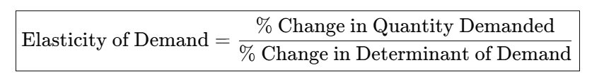
Elasticity of Demand
Demand usually varies with price. But the extent of variation is not uniform in all cases. In some cases, the variation is extremely wide; in some others, it may just be nominal. That means sometimes demand is greatly responsive to changes in price; at other times, it may not be so responsive. The economists, to measure this responsiveness or the extent of variation, use the term “elasticity.”
According to Alfred Marshall ”Elasticity of demand may be defined as the percentage change in quantity demanded to the percentage change in price.”

Slide 27
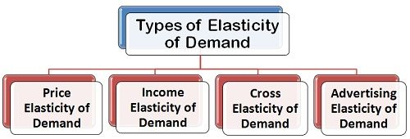

Slide 28
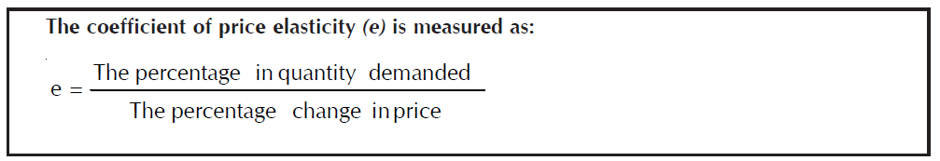
1.Price Elasticity of Demand
Price elasticity of demand (PED) measures the responsiveness of the quantity demanded of a good to a change in its own price.
For example, if price increases by 10% and demand decreases by 20%, the elasticity is -2, indicating elastic demand.
It is calculated as:

Slide 29
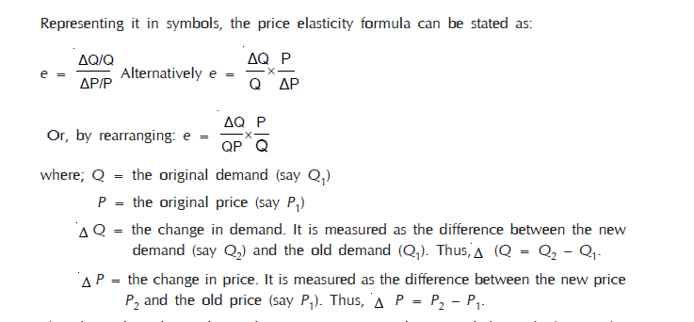

Slide 30
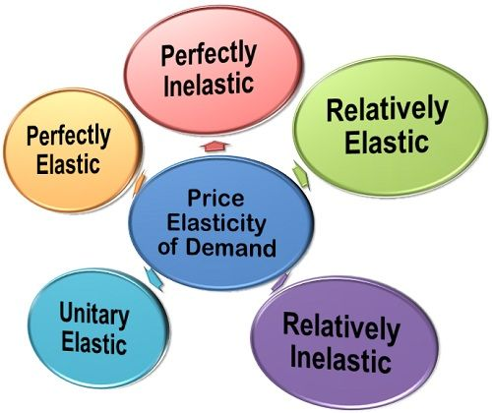

Slide 31
Perfectly Elastic Demand: An endless demand at the given price is the case of perfectly elastic demand. When demand is perfectly elastic, with a slight or infinitely small rise in the price of a commodity, the consumer stops buying it.
Perfectly Inelastic Demand: When the demand for a commodity shows no response at all to a change in price. That is to say, whatever change in price, the demand remains the same, it is called a perfectly inelastic demand. Perfect inelasticity is again a theoretical consideration rather than a very practical phenomenon. However, a commodity of absolute necessity like salt seems to have perfectly inelastic demand for most consumers.
Relatively Elastic Demand: When the proportion of change in the quantity demanded is greater than that of price, the demand is said to be relatively elastic. The numerical value of relatively elastic demand lies between one and infinity. Thus, what Marshall called elasticity greater than unity of demand is again referred to as “relatively elastic” demand or “more elastic” demand.
Relatively Inelastic Demand: When the proportion of change in the quantity demanded is less than that of price, the demand is considered to be relatively inelastic.

Slide 32
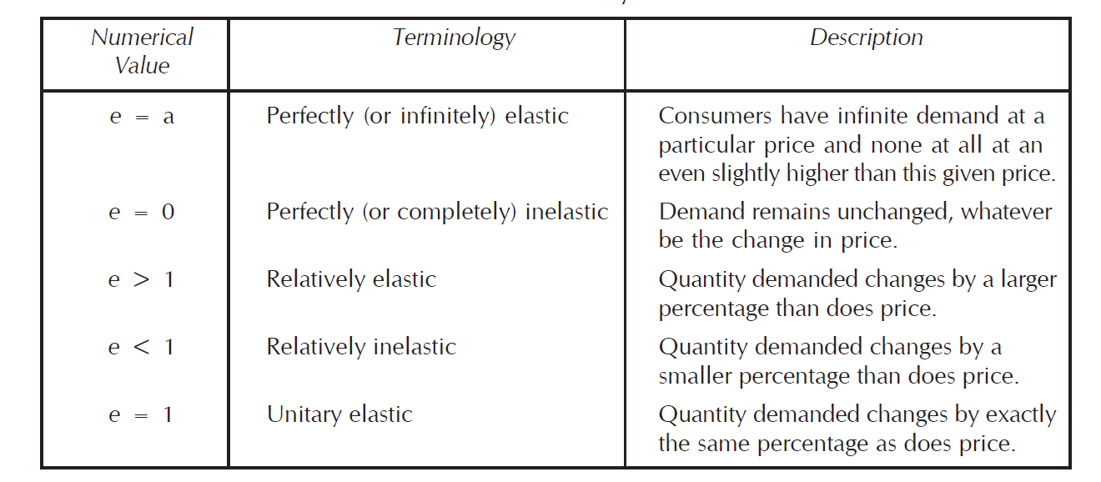
The numerical value of relatively inelastic demand lies between zero and one. Hence, the concept “relatively inelastic” or “less elastic” demand is the same as what Marshall presented.
Unitary Elastic Demand: When the proportion of change in demand is exactly the same as the change in price, the demand is said to be unitary elastic. The numerical value of unitary elastic demand is exactly 1.

Slide 33
FACTORS INFLUENCING ELASTICITY OF DEMAND
Nature of commodity
Availability of substitutes
Number of uses
Consumer’s income
Height of price and range of price change
Proportion of expenditure
Durability of the commodity
Habit
Complementary goods
Time
Recurrence of demand
Possibility of postponement

Slide 34

2.Income Elasticity of Demand
Income elasticity shows how demand changes with consumer income.
D = f (M)
Where, M refers to the money i.e. income of the buyer. It suggests that the demand may change due to a change in the consumer’s income and other factors remaining constant.
The income elasticity is defined as a ratio percentage or proportional change in the quantity demanded to the percentage or proportional change in income.

Slide 35
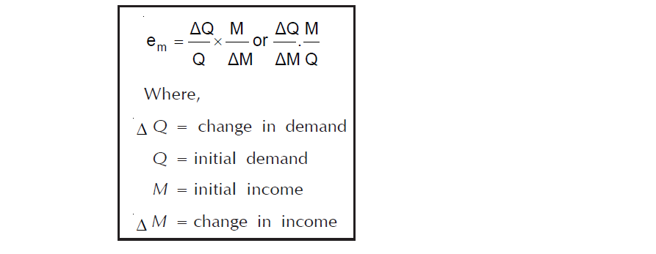
TYPES OF INCOME ELASTICITY:
Income elasticity on the basis of its coefficient (em), may thus be classified as under:
Unitary income elasticity of demand (em = 1)
Income elasticity of demand greater than unity (em > 1)
Income elasticity of demand less than unity (em < 1)
Zero income elasticity of demand (em = 0)
Negative income elasticity of demand (em < 0)

Slide 36
Unitary Income Elasticity: When the percentage change in demand is equal to the percentage change in income, the demand is unitary income elastic. Thus, em = 1.
Income Elasticity Greater than Unity: When the percentage change in quantity demanded is greater than the percentage change in income, the income elasticity of demand is greater than unity. Thus, em > 1.
Income Elasticity Less than Unity: When the percentage change in demand is less than the percentage change in price, the income elasticity of demand is less than unity. Thus, em < 1.
Zero Income Elasticity: When the income change in any direction or in any proportion but carries no effect on demand, so that the quantity demanded remains unchanged, it is referred to as zero income elasticity of demand. Thus, em = 0.
Negative Income Elasticity: When an increase in income causes a decrease in the demand for a commodity, the demand is said to be negative income elastic. The income elasticity coefficient, em < 0.

Slide 37
APPLICATIONS OF INCOME ELASTICITY:
K.K. Seo points out that income elasticity of demand is applicable to many planning and strategy problems, such as:
Long-term business planning. In the long-run, demand for comforts and luxury goods may tend to be highly income elastic. Hence, prospects for long-run growth in sales for these goods are very bright. The firm can plan out its business accordingly.
Market strategy. Income elasticity of demand is helpful in developing market strategies.
Housing development strategies. On the basis of income elasticity, housing development requirement can be predicted and construction work can be effectively launched upon.

Slide 38
3.Cross Elasticity of Demand
The cross elasticity demand refers to the degree of responsiveness of demand for a commodity to a given change in the price of some related commodity. The cross elasticity of demand measures the extent to which products are substitute or complementary. A positive cross elasticity of demand indicates that the two products in consideration are substitutes, since an increase/decrease in the price of one causes an increase/ decrease in the quantity demand of the other. A negative cross elasticity of demand indicates that the two products in consideration are complementary to each other, since an increase/decrease in the price of one leads to a contraction/extension in demand for the other.

Slide 39
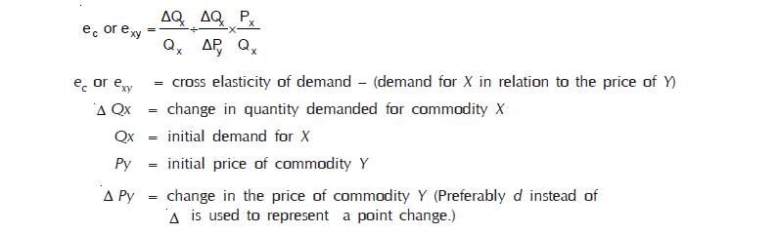

Slide 40
5.ADVERTISING OR PROMOTIONAL ELASTICITY OF DEMAND
Promotional elasticity measures how demand responds to advertising and promotional expenditures. In case of several products, the market demand is influenced through advertisement or promotional efforts.
Qx = f (A)
where, Qx = Demand for the product x measured through the quantity sold in the market.
A = Advertisement expenditure of the firm.

Slide 41
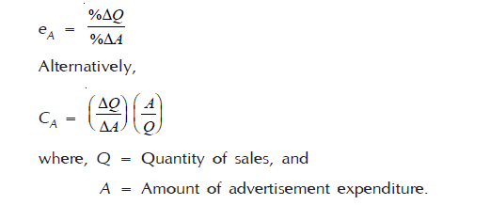

Slide 42
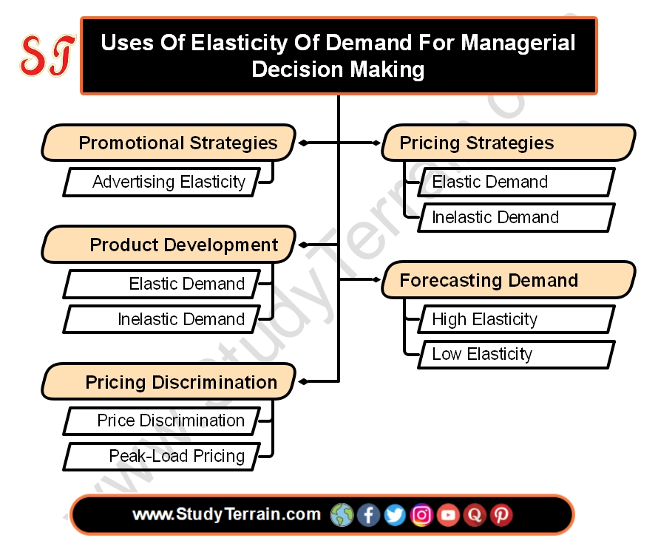

Slide 43

The amount of stock a product offered for sale in the market at a given price per unit of time. Supply is what the producer or seller is able and willing to produce and offer for sale at a particular price in a given market at a particular period of time.

Slide 44
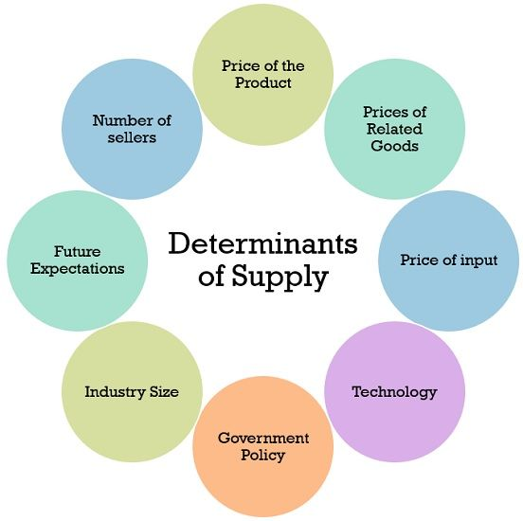

Slide 45
Determinants of supply:
Production Costs/Input Prices: The cost of factors of production (e.g., labor, raw materials, energy) directly affects the profitability of supplying a good. An increase in these costs reduces supply, while a decrease in these cost increases supply.
Technology: Improvements in technology typically enhance efficiency, reduce production costs, and thereby increase supply.
Number of Sellers/Firms: An increase in the number of producers in the market leads to an increase in the total market supply. Conversely, firms leaving the market reduce supply.
Expectations of Future Prices: If producers anticipate higher prices in the future, they may withhold some of their current supply to sell later at a more favorable price, thus reducing current supply.
Government Policy (Taxes and Subsidies): Taxes increase production costs and reduce supply, while subsidies lower costs (or provide financial incentives) and increase supply.
Natural Factors: For agricultural products and other primary commodities, natural events or weather conditions can significantly impact supply.

Slide 46


Slide 47
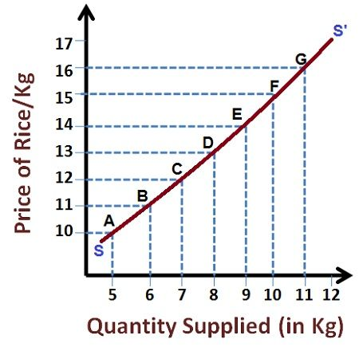
It is a fundamental principle of economic theory which states that, all else are equal, an increase in price result in an increase in quality supplied. There is a positive relationship in between quantity supplied and price. The law thus suggests that the supply varies directly with the change in price.

Slide 48
Assumptions of The Law of Supply
No Change in Technology: Technological advancements can reduce production costs, leading to an increase in supply regardless of price changes. The law of supply assumes that technology remains constant.
Constant Input Prices: Changes in the prices of inputs, such as raw materials, labor, and energy, can affect the cost of production and, consequently, the supply of a good or service. The law assumes that input prices remain stable.
No Change in Government Policies: Government policies, such as taxes, subsidies, and regulations, can influence the supply of goods and services. The law assumes that these policies remain unchanged.
No Change in Expectations: Expectations about future prices can also affect current supply decisions. For example, if suppliers expect prices to rise in the future, they may reduce current supply to sell more at the higher future price. The law assumes that expectations remain constant.

Slide 49
Exceptions to the Law of Supply
Perishable Goods: In the case of highly perishable goods, such as fresh produce, suppliers may be willing to sell their entire stock even at a lower price to avoid spoilage and losses.
Rare and Unique Items: For rare and unique items, such as antiques or works of art, the supply is often fixed and cannot be increased regardless of price.
Backward-Bending Supply Curve of Labor: At very high wage rates, workers may choose to work fewer hours, preferring leisure over additional income. This can lead to a backward-bending supply curve of labor, where the quantity of labor supplied decreases as the wage rate increases.
Agricultural Goods: In some cases, the supply of agricultural goods may be influenced by factors such as weather conditions and natural disasters, which can override the price effect.
Goods with Prestige Value: For some goods, a lower price might reduce the perceived prestige or exclusivity, leading to a decrease in demand and, consequently, a decrease in the quantity supplied.

Slide 50
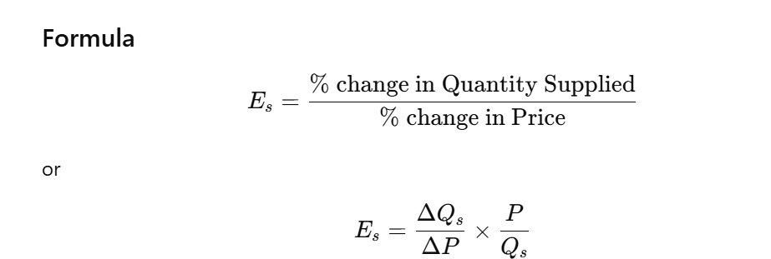
Elasticity of Supply
Elasticity of Supply (Es) measures how much the quantity supplied of a good responds to a change in its price. It tells us whether producers can easily increase or decrease supply when prices change.

Slide 51
Types of Elasticity of Supply
Perfectly Elastic Supply (Es = ∞): Supply changes infinitely even if price changes slightly. Producers are willing to supply any amount at a particular price. If price falls even slightly, supply becomes zero. Example: In a perfectly competitive market, if the market price of wheat is ₹20/kg, farmers will supply any amount at that price. But if price becomes ₹19.90, they will stop.
Perfectly Inelastic Supply (Es = 0): Quantity supplied does NOT change even when price changes. Supply is completely fixed. Happens when goods are rare or production cannot be increased. Example: Supply of land in a city cannot increase even if prices rise. And Rare paintings (e.g., by M.F. Husain) have fixed supply — no new artworks can be produced.
Relatively Elastic Supply (Es > 1): A small change in price causes a large change in quantity supplied. Producers can quickly increase production. It happens when resources are easily available and production is flexible. Example: Price of cotton shirts rises by 5%, and tailors produce 20% more shirts. Factories can easily increase output by using machines for extra hours.

Slide 52
Relatively Inelastic Supply (Es < 1): A large change in price results in only a small change in quantity supplied. Producers cannot increase supply quickly. It happens in short run, or when inputs are limited. Example: Price of onions rises by 30%, but farmers can increase supply only by 10%. Agricultural goods are usually inelastic in the short period because crops take time to grow.
Unitary Elastic Supply (Es = 1): % change in supply = % change in price. Supply increases in the same proportion as price. Rare in real life but useful for theory. Example: Price rises by 10%, and quantity supplied also rises by 10%. Some manufactured goods may behave like this under controlled production conditions.

Slide 53
Demand Forecasting

Slide 54
Forecasting means expectations about the future course of development. The future is uncertain. But, not entirely so. Hence, one can hopefully predict the future event and reasonably gain. Demand forecasting means expectation about the future course of the market demand for a product. Demand forecasting is based on the statistical data about past behavior and empirical relationships of the demand determinants.
Demand forecasting may be undertaken at the following levels:
Micro level: It refers to the demand forecasting by the individual business firm for estimating the demand for its product.
Industry level: It refers to the demand estimate for the product of the industry as a whole. It is undertaken by an Industrial or Trade Association. It relates to the market demand as a whole.
Macro level: It refers to the aggregate demand for the industrial output by the nation as a whole. It is based on the national income or aggregate expenditure of the country. Country’s consumption function provides an estimate for the demand forecasting at macro level.

Slide 55
SIGNIFICANCE OF DEMAND FORECASTING
Demand forecasting is very essential in the course of business decision-making. Its significance may be traced as under:
Production Planning: Demand forecasting is a prerequisite for the production planning of a business firm. Expansion of output of the firm should be based on the estimates of likely demand, otherwise there may be overproduction and consequent losses may have to be faced.
Sales Forecasting: Sales forecasting is based on the demand forecasting. Promotional efforts of the firm should be based on sales forecasting.
Control of Business: For controlling the business on a sound footing, it is essential to have a well conceived budgeting of costs and profits that is based on the forecast of annual demand/sales and prices.

Slide 56
Inventory Control: A satisfactory control of business inventories, raw materials, intermediate goods, semi-finished product, finished product, spare parts, etc., requires satisfactory estimates of the future requirements which can be traced through demand forecasting.
Growth and Long-term Investment Programmes: Demand forecasting is necessary for determining the growth rate of the firm and its long-term investment programmes and planning.
Stability: Stability in production and employment over a period of time can be made effective by the management in the light of the suitable forecasting about market demand and other business variables and smoothening of the business operations through counter-cyclical and seasonally adjusted business programmes.
Economic Planning and Policy-Making: Demand forecasting at macro level for the nation as a whole is of a great help to the planners and policy-makers for a better planning and rational allocation of the country’s productional resources. The government can determine its import and export policies in view of the long-term demand forecasting for various goods in the country.

Slide 57
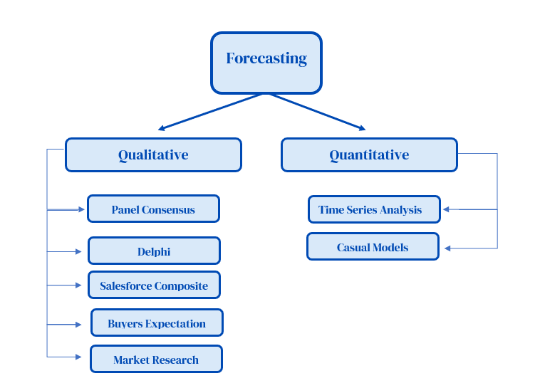

Slide 58
Qualitative Methods of Forecasting
These methods rely on expert opinions, surveys, and market research to predict future demand, especially when historical data is limited or unreliable.
1. Panel Consensus: The Panel Consensus method involves gathering a group of experts, often from different departments within a company (e.g., marketing, sales, production, finance), to discuss and collectively develop a demand forecast. The experts share their individual insights, assumptions, and knowledge to arrive at a consensus forecast.
2. Delphi Method: The Delphi Method is a structured communication technique used to obtain a consensus forecast from a panel of experts without bringing them together physically. This method aims to minimize the influence of dominant personalities and groupthink by keeping the experts anonymous and facilitating iterative feedback.
3. Salesforce Composite: The Salesforce Composite method relies on the collective knowledge and insights of the sales force to forecast demand. Sales representatives are closest to the customers and have firsthand knowledge of their needs, preferences, and purchasing intentions.

Slide 59
4. Buyers Expectation Survey: The Buyers' Expectation Survey method involves directly surveying potential customers to gauge their future purchasing intentions. This method provides valuable insights into customer demand and can help companies to anticipate changes in the market.
5. Market Research: Market research encompasses a broad range of techniques used to gather information about customers, competitors, and the overall market environment. This information can be used to develop demand forecasts and make informed business decisions.

Slide 60
Quantitative Methods of Forecasting
Time Series Analysis: Time series analysis is a statistical method used to predict future values based on historical data points collected over time. It assumes that past patterns and trends can be extrapolated to forecast future demand. This approach is particularly useful when historical data is readily available and when the underlying factors influencing demand are relatively stable.
Techniques:
Trend Projection Method
Moving Averages
Exponential Smoothing
Causal Models: Causal models also known as explanatory models, attempt to identify and quantify the relationships between demand and other variables that influence it. These models aim to explain why demand changes and use these relationships to forecast future demand.
Techniques:
Regression Analysis
Econometric Models
Input-Output Models

Slide 61
Thank You

